Slide 1
2
M.DANI SETIAWAN
&
ZENITH HERIYANTO

Slide 2
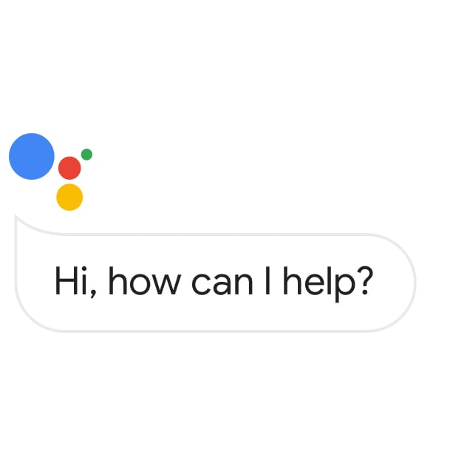
Artificial Intelligence (AI)
Technology In Google Assistant

Slide 3

What is Artificial
Intelligence ?

Slide 4
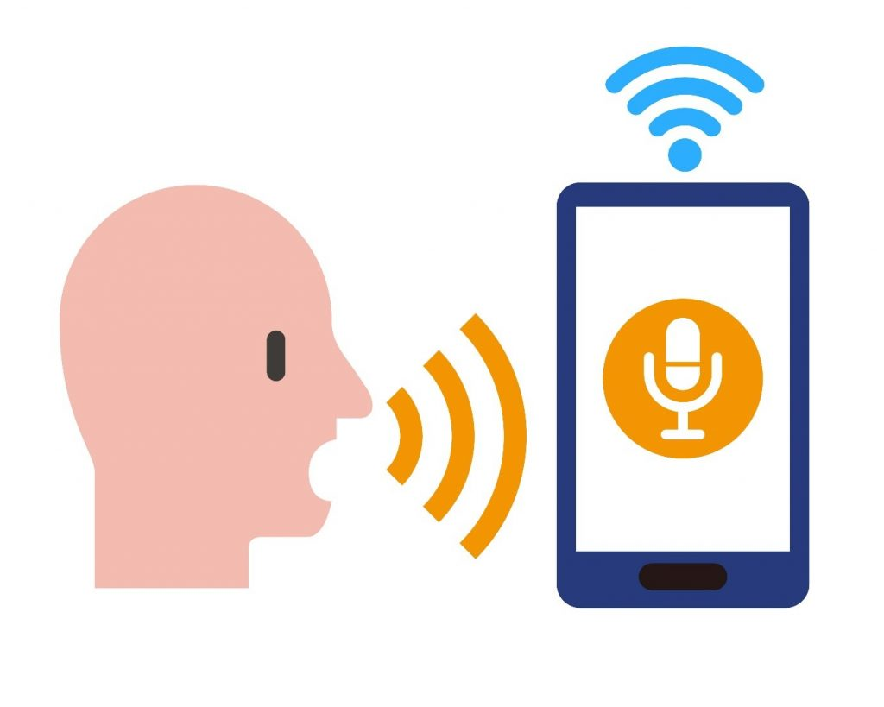
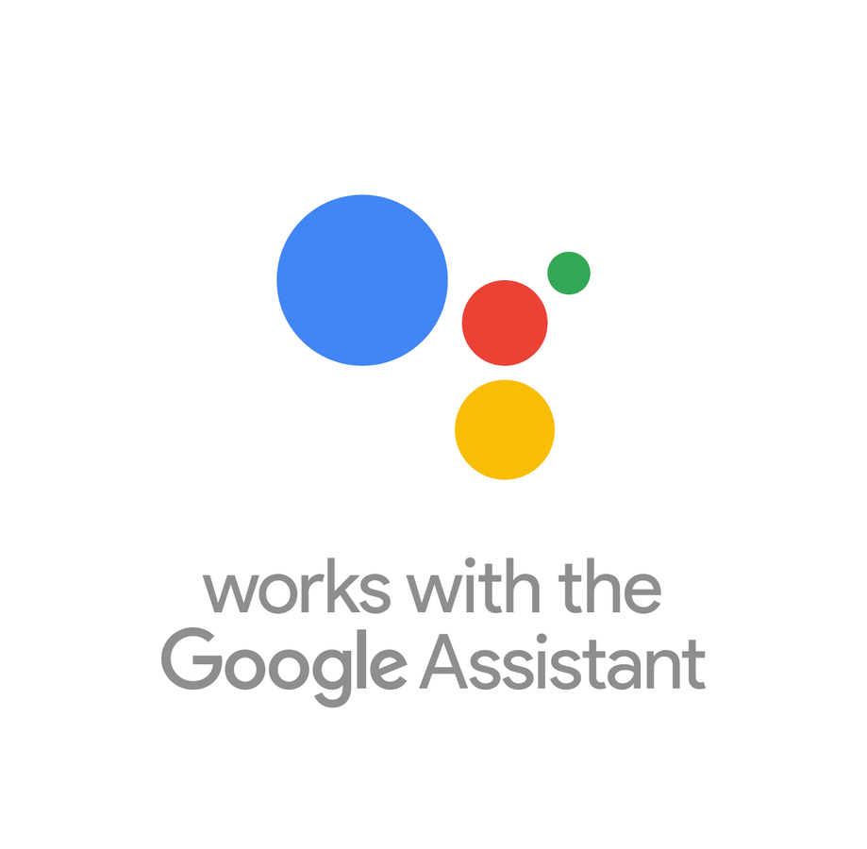
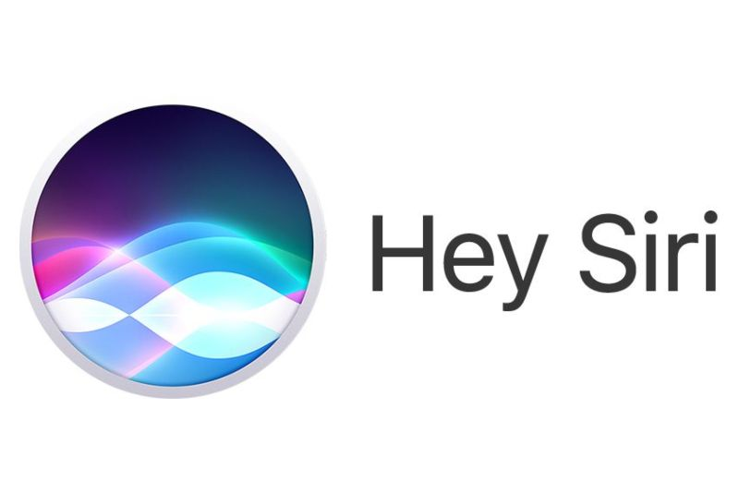


Voice Recognition
Voice Recognition is the ability of a machine or program to receive and interpret dictation or to understand and carry out spoken commands.

Slide 5
Google Assistant
Google Assistant is an artificial intelligence powered virtual assistant developed by Google that is primarily available on mobile and smart home devices.
Assistant initially debuted in May 2016 as part of Google's messaging app Allo
After a period of exclusivity on the Pixel and Pixel XL smartphones, it began to be deployed on other Android devices in February 2017.
the first Assistant powered smart displays (smart speakers with video screens) were announced, with the first one being released in July 2018.

Slide 6
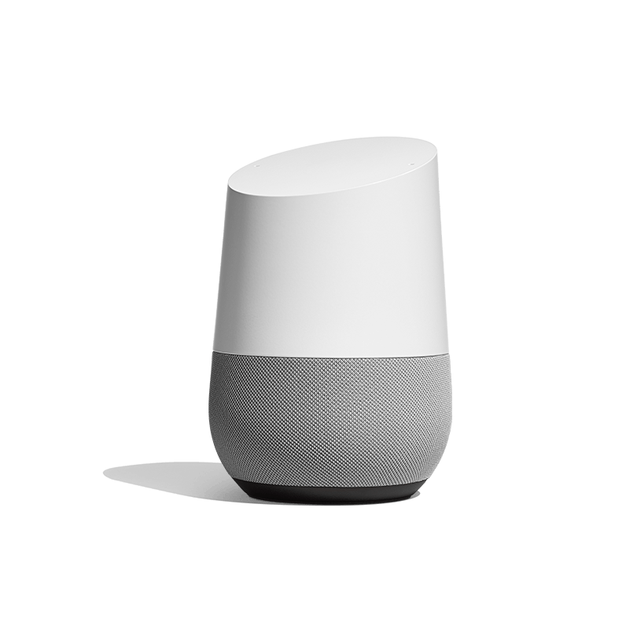
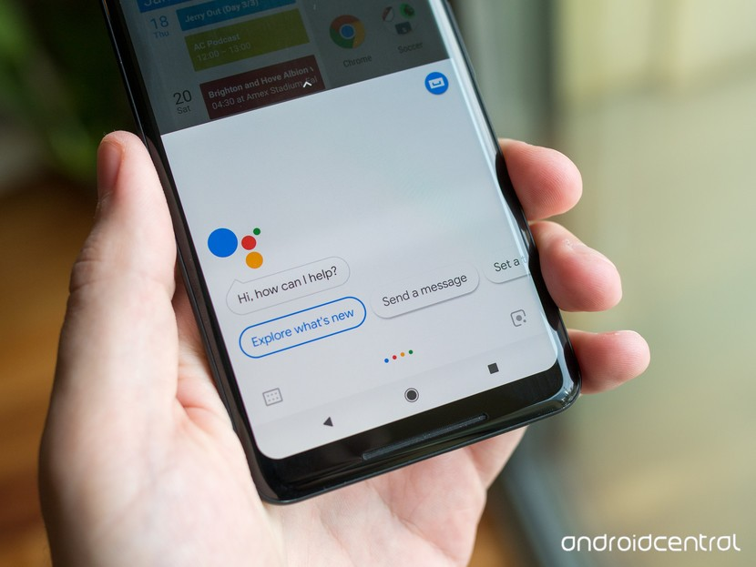
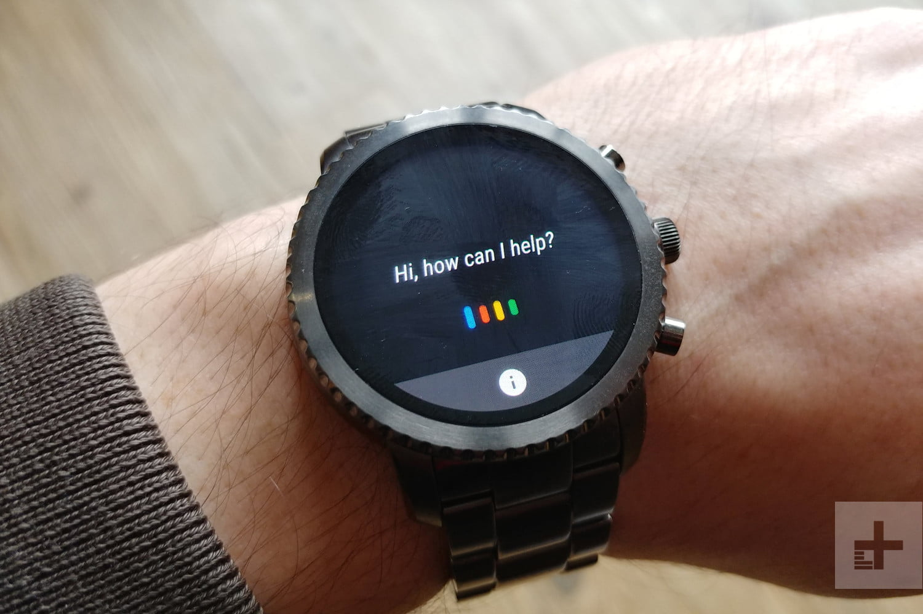
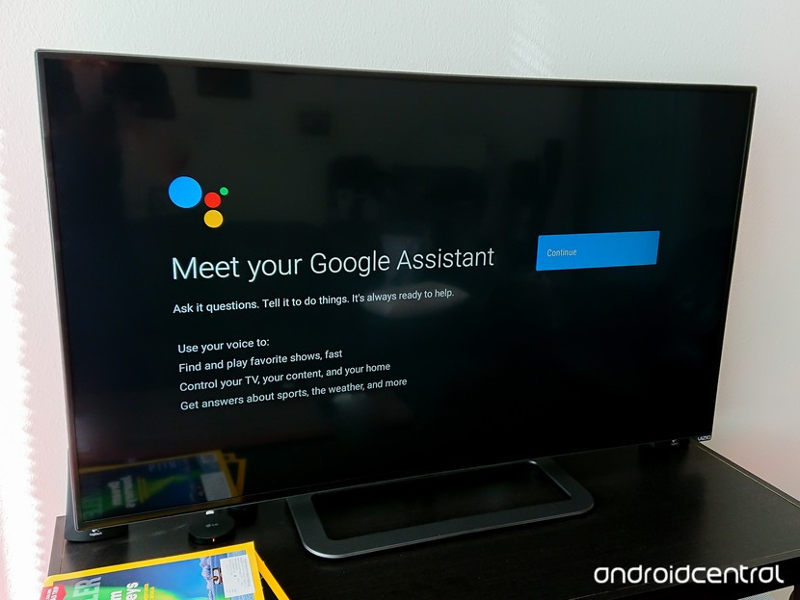
DEVICE IN GOOGLE ASISSTANT
ANDROID PHONE
SMARTWATCH
ANDROID TV
GOOGLE HOME

Slide 7
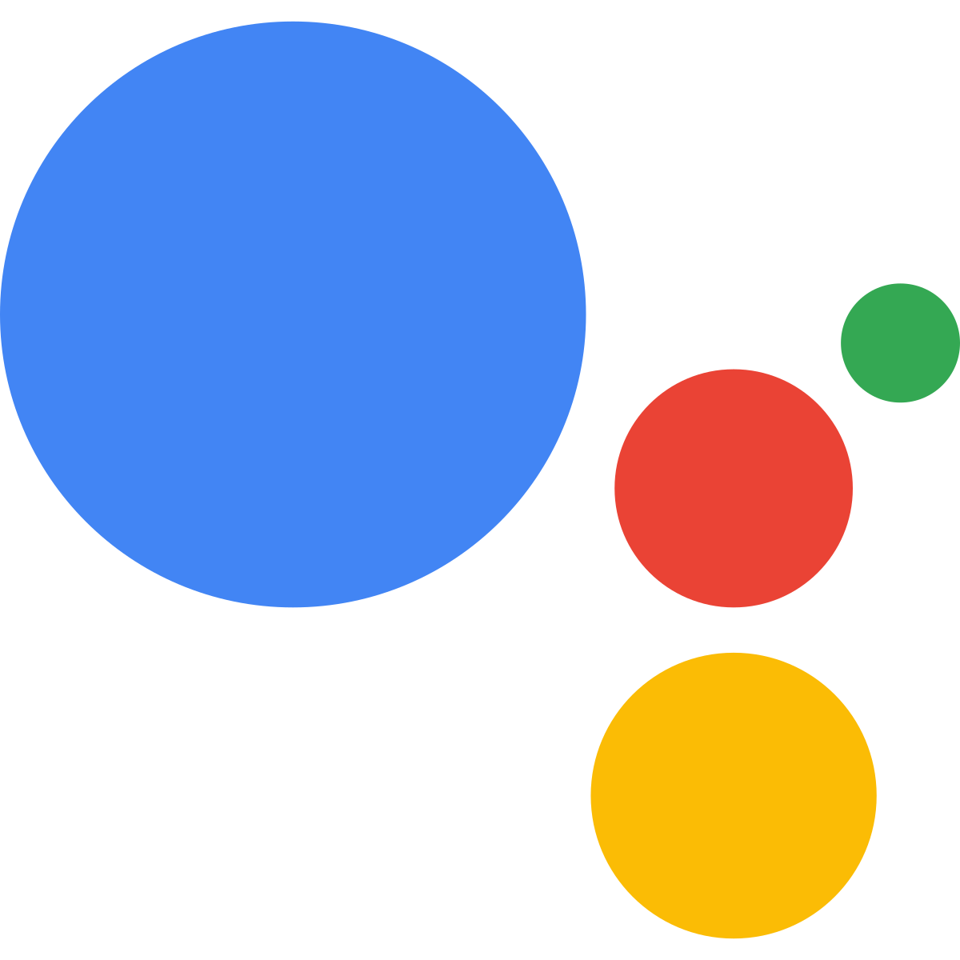
What can Google Assistant do ?
Control your devices and your smart home
Access information from your calendars and other personal information
Find information online, from restaurant bookings to directions, weather and news
Control your music
Play content on your Chromecast or other compatible devices
Run timers and reminders
Make appointments and send messages
Open apps on your phone
Read your notifications to you
Real-time spoken translations

Slide 8
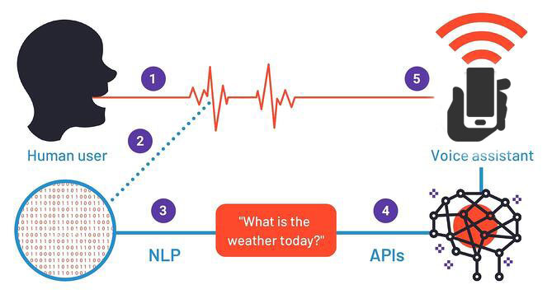
How Does it Work ?
Some bots use passive listening
Voice recognition kicks in
Followed by natural language processing
Information retrieval takes place
Information is then output

Slide 9
THANK YOU FOR ATTENTION ☺

